Slide 2
How the Department of Defense moved to Kubernetes and Istio!
Nicolas M. Chaillan,
U.S Air Force Chief Software Officer
Co-lead for the DoD Enterprise DevSecOps Initiative.

Slide 3
Problem Statement
The Department of Defense (DoD) is still mostly using Waterfall software methodologies with software delivery every 3 to 10 years, making it impossible to keep up with the pace of technology.
The DoD Authority to Operate (ATO) process to accredit software takes, on average, 8 months and is mostly manual with several testing and cybersecurity gates.
Most of the Defense Industrial Base (DIB) (the DoD contractors and developers) have not adopted an Agile and/or DevOps mindset.
Massive organization with large silos and large workforce.
Limited Talent pool, IT enterprise services, Cloud access and high speed connectivity.

Slide 4
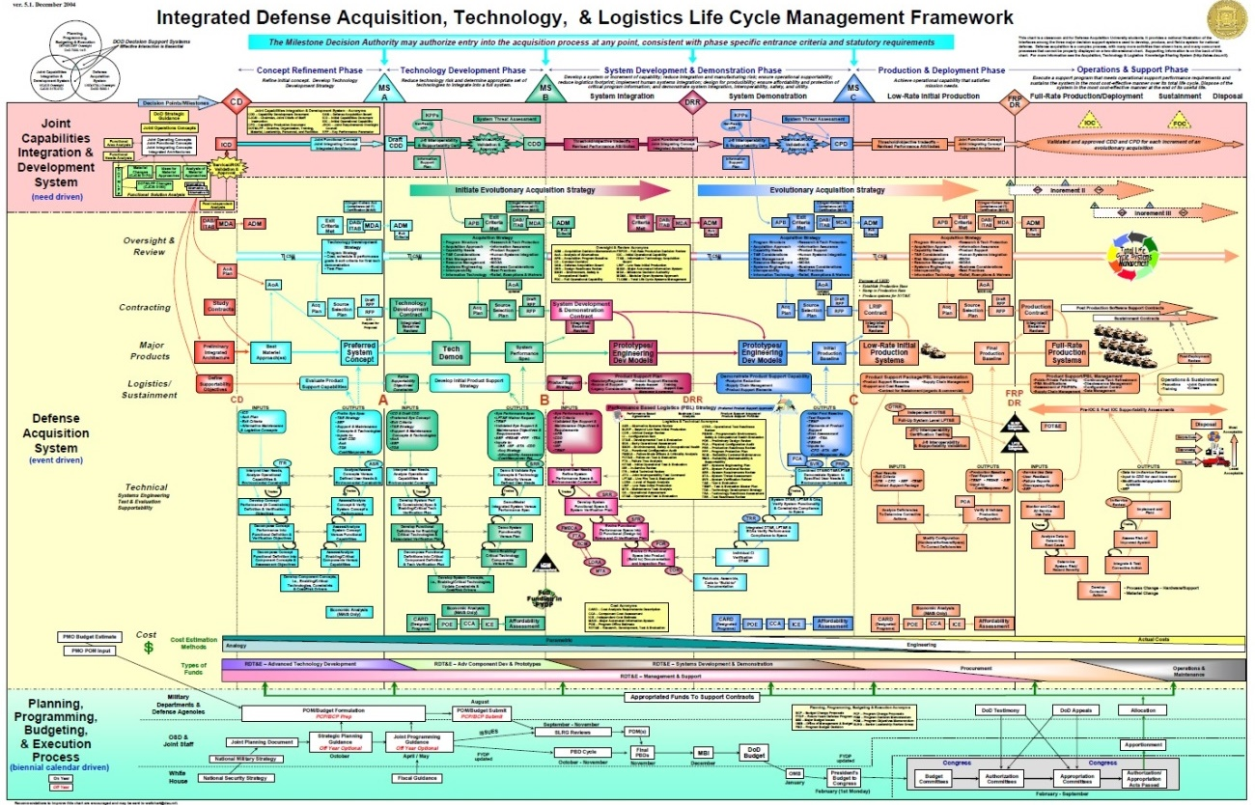
Do You See A Problem?

Slide 5
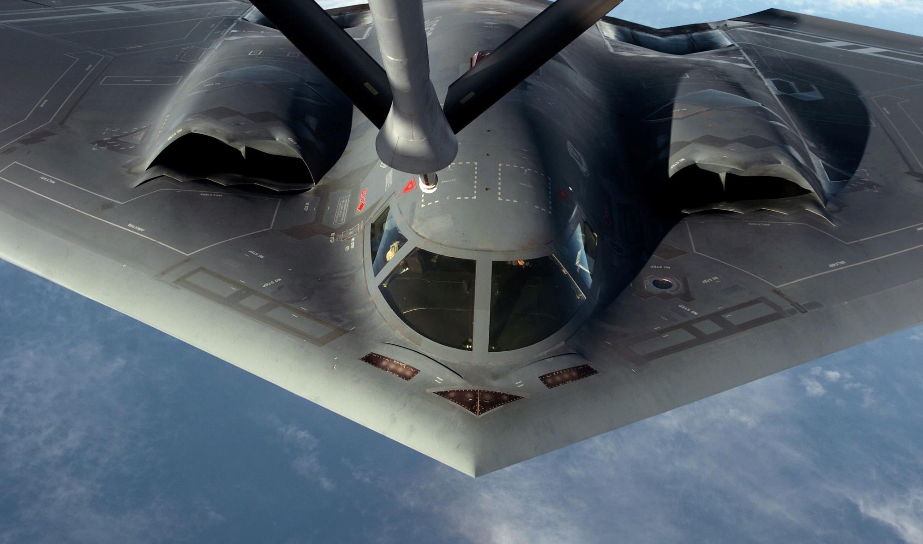
Must Rapidly Adapt to Challenges

Slide 6
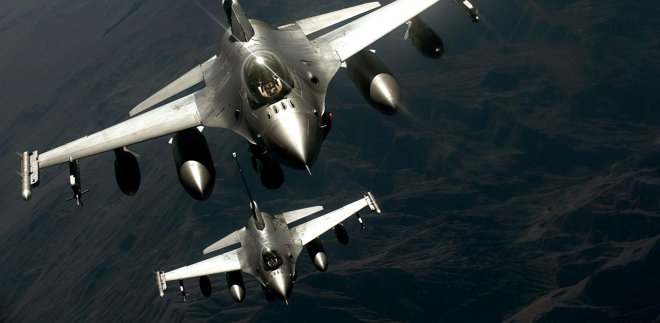
Work as a Team

Slide 7

A Large Team!

Slide 8

With Various Technologies!

Slide 9
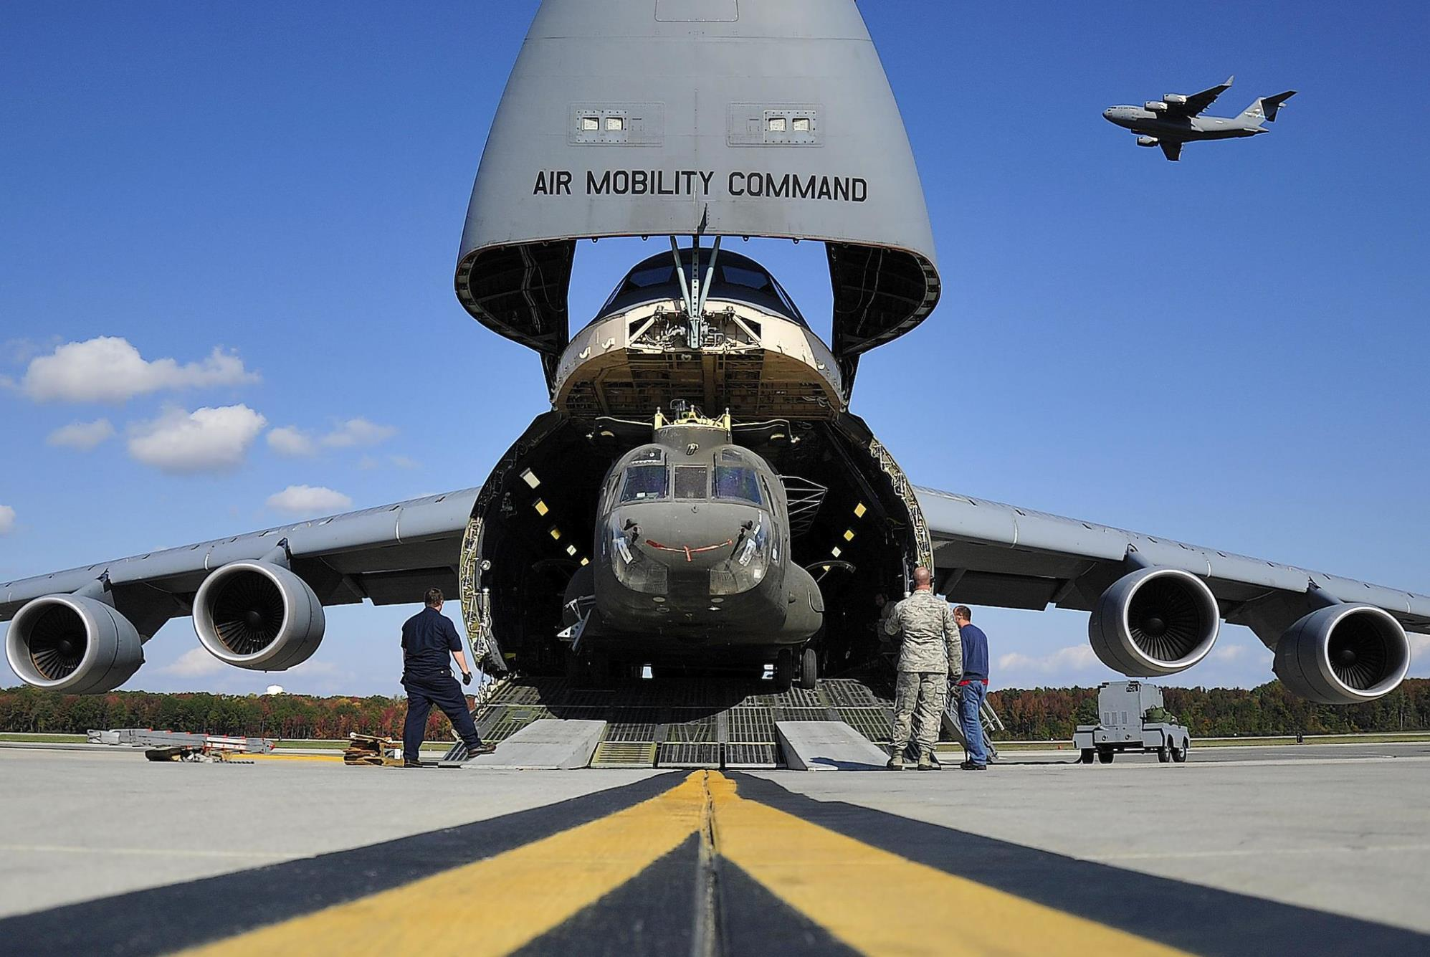
And Bring It With Us!

Slide 10

Even To Space!

Slide 11

With A Few Sensors!

Slide 12
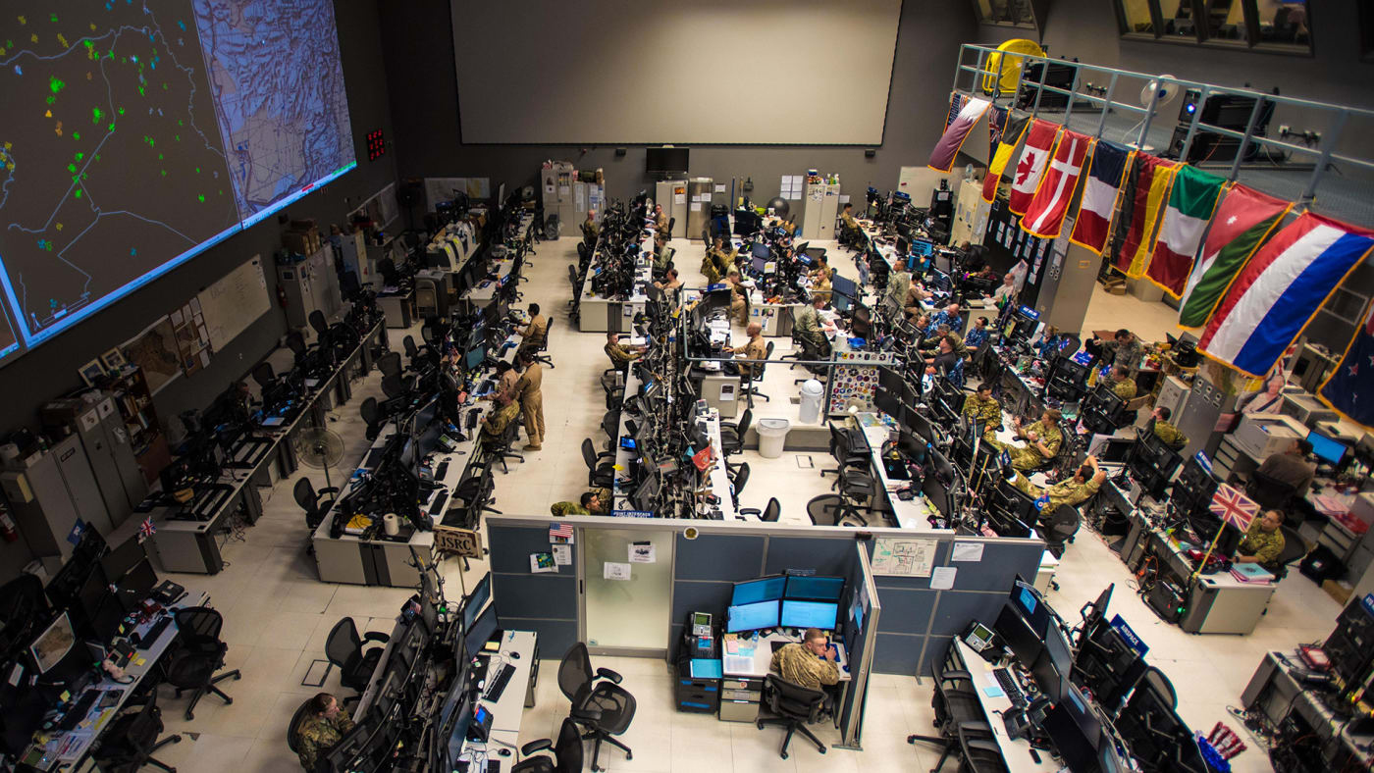
With Lots of Help!

Slide 13

While Building SW Innovations!

Slide 14
DoD Enterprise DevSecOps Initiative
Tangible Technology – Our entire DevSecOps stack is open source and public, please contribute!
Avoid vendor lock-in at the Infrastructure and Platform Layer by leveraging FOSS with Kubernetes and OCI containers,
Creating the DoD Centralized Artifacts Repository (DCAR) of hardened and centrally accredited containers: selecting, certifying, and securing best of breed development tools and software capabilities (over 170+ containers) - https://dccscr.dsop.io/dsop/ and https://dcar.dsop.io
Baked-in Zero Trust Security with our Sidecar Container Security Stack (SCSS) leveraging behavior detection, zero trust down to the container/function level.
Leveraging a Scalable Microservices Architecture with Service Mesh/API Gateway and baked-in security (Istio)
Leveraging KNative to avoid lock-in to Cloud provider Serverless/Function as a Service stacks
Customized Open Policy Agent (OPA) Policies!
Bringing Enterprise IT Capabilities with Cloud One and Platform One – Cloud and DevSecOps as Managed Services capabilities, on-boarding and support!
Standardizing metrics and define acceptable gates/thresholds for DoD-wide continuous Authority to Operate
Massive Scale Training with Self Learning Capabilities (train over 100K people within a year) and bring state of the art DevSecOps curriculums
Creating new Agile contracting language to enable and incentivize the use of DevSecOps

Slide 15


Understanding the DevSecOps Layers
Continuous Monitoring
Leverages the Sidecar Container Security Stack
Development Teams can build software/microservices leveraging hardened containers
TEAM
Application
Layer
Brings baked-in security and
Microservices architecture enablement
Platform
One
Service Mesh
Layer
Fully containerized, leverages DoD approved containers from DCAR
Development Team selects tools from 172 approved containers or custom containers
Continuous Integration / Continuous Delivery
(CI/CD) Layer
CNCF compliant Kubernetes (K8S)
Includes Site Reliability Engineers (SREs) etc.
Development Team selects between approved K8S stacks
Platform
Layer
Environment Agnostic
Cloud One Preferred for unclassified (IL2, IL4, IL5)
Or SC2S/C2S/FENCES
Or on-premise/classified environments
Cloud One
Infrastructure
Layer

Slide 16


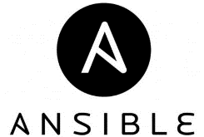
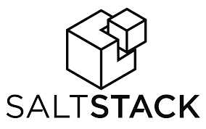
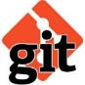





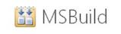

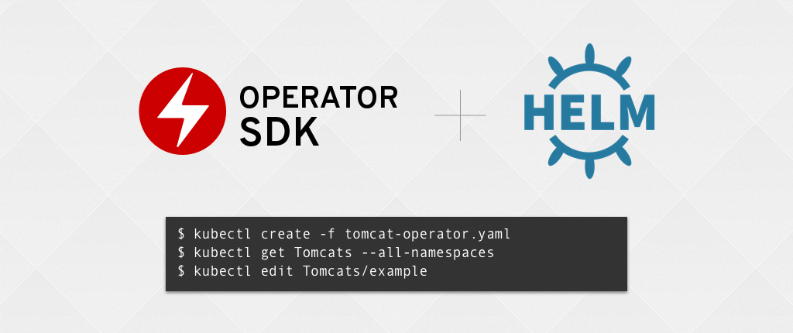





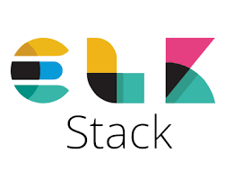


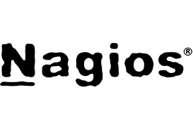



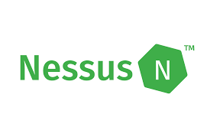

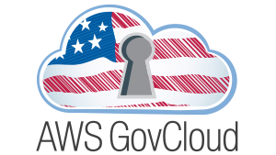






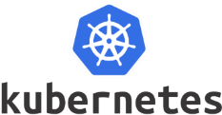




DoD Enterprise DevSecOps
Technology Stack
ENTIRELY CONTAINERIZED
(Exemplar)
PLAN
&
DEVELOP
DEPLOY
&
OPERATE
BUILD
“Continuous Integration &
Continuous Delivery”
Orchestration
MONITOR
TEST
SECURE
SCALE
STORE ARTIFACTS
Container and Container Management

Slide 17
Sidecar Container Security Stack
Baked-in Zero Trust security down to the Container/Function level with Istio (Envoy) and Knative.
Centralized logging and telemetry with Elasticsearch, Fluentd, Kibana (EFK).
Container security: Continuous Scanning, Alerting, CVE scanning, Behavior detection both in development and production (Build, Registry, Runtime) with Twistlock
Container security and insider threat (custom policies detecting unapproved changes to Dockerfiles) with Anchore
Automated STIG compliance with OpenSCAP

Slide 18

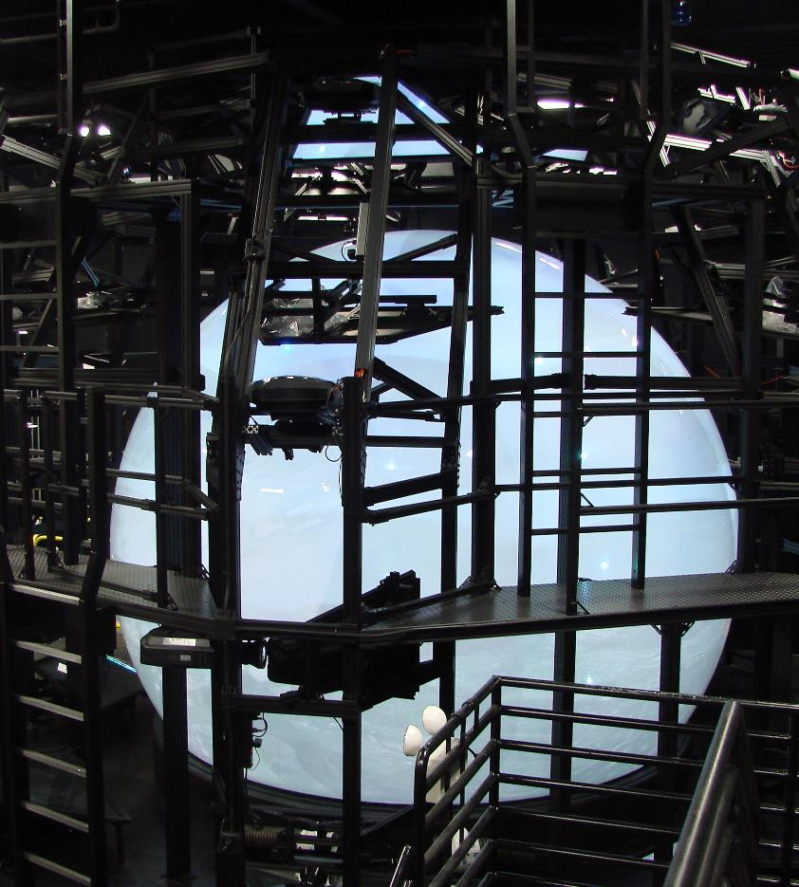
They built pretty cool Simulators!

Slide 19
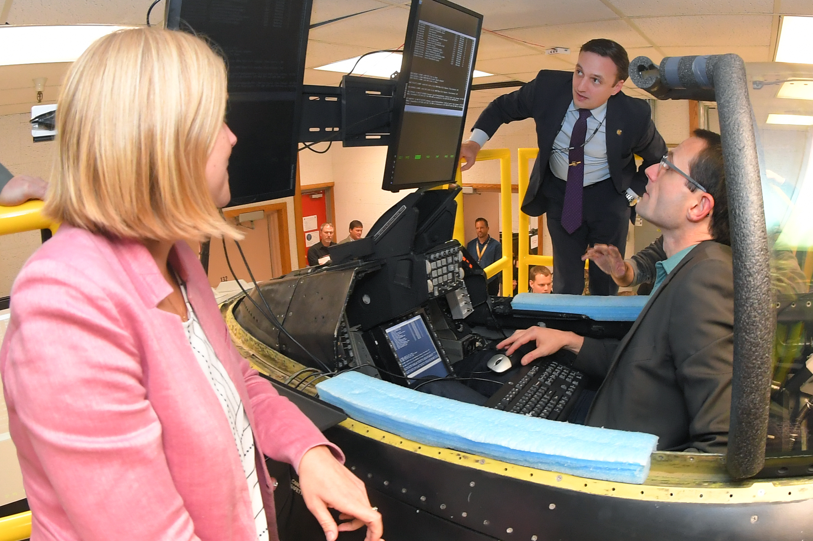
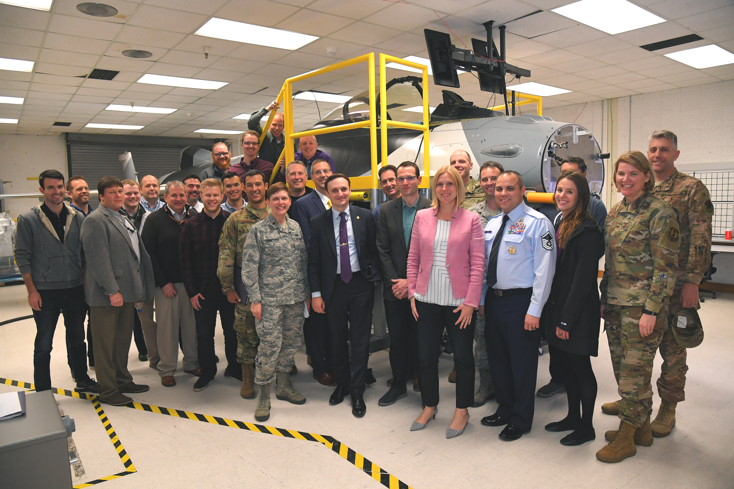
Our 45-day MVP: K8S/Istio on F-16 jet!

Slide 20

Join/Contact Us!
“If Kubernetes is good enough for DoD weapon systems, it is definitely good enough for your business!”
JOIN US AND MAKE A DIFFERENCE!
https://software.af.mil
Nicolas M. Chaillan
Chief Software Officer, U.S. Air Force
https://www.linkedin.com/in/nicolaschaillan/
usaf.cso@mail.mil

Slide 21
BACKUP SLIDES

Slide 22
DoD Enterprise DevSecOps Architecture*
Centralized DoD Enterprise DevSecOps Artifacts Repository
Continuously
Hardens Docker Public Images and Assesses Open Source Libraries
Program
Source code repository
pulls
Bare-metal, GovCloud, AWS Secret, Azure Secret,
mil Cloud, C2S, Jedi…***
Application / Microservices
built by DoD Programs.
Artifacts Repository**
pulls
DoD Enterprise DevSecOps Platform**
pulls
Microservices Architecture (ISTIO)
Sidecar Container Security Stack
DoD OCIO/DISA
Centralized
Logs/Telemetry****
DevSecOps
CI/CD pipeline**
Elasticsearch
pulls
Fluentd Real-time pushes
pulls
Kubernetes
Per DoD Service for Service-wide Visibility
Logs/Telemetry****
*each DoD Program can have its own instantiation of the DoD Enterprise DevSecOps Platform on any Cloud.
** can be installed with single command and deployed on any Cloud.
*** could be deployed inside an enclave or on-premises
**** gives complete visibilities of assets, security/vulnerability state etc. can be integrated to existing cybersecurity shared services.
Optional Abstraction Layer with
Red Hat OpenShift or PKS or CNCF compliant Kubernetes Product

Slide 23
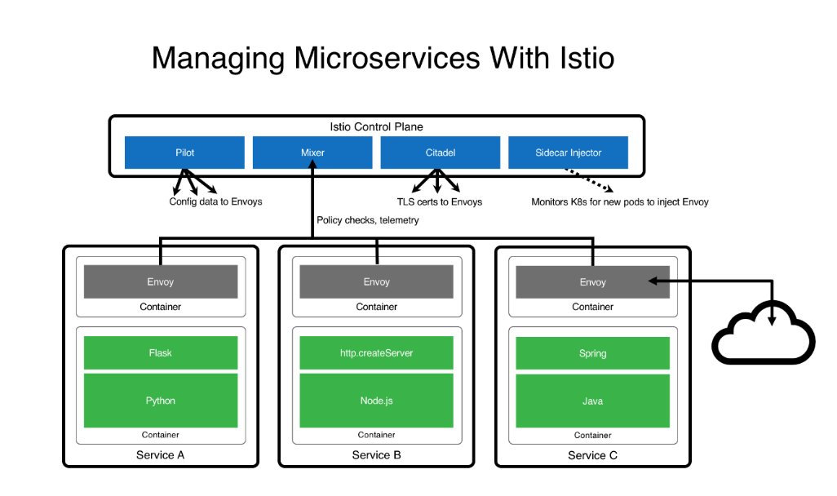
Microservices Architecture (ISTIO)
Turnkey Service Mesh (ISTIO) architecture
ISTIO side car proxy, baked-in security, with visibility across containers, by default, without any developer interaction or code change
Benefits:
API Management, service discovery, authentication…
Dynamic request routing for A/B testing, gradual rollouts, canary releases, resilience, observability, retries, circuit breakers and fault injection
Layer 7 Load balancing
Zero Trust model: East/West Traffic Whitelisting, ACL, RBAC…
TLS encryption by default, Key management, signing…

Slide 24
DevSecOps Product Stack (1)
Source Repository GitHub Government GitLab Container Management technologies: Kubernetes Openshift VMWare Tanzu PKS OKD Rancher (K8S only) D2IQ (K8S only) Docker EE (K8S only) Container Packagers: Helm Kubernetes Operators | API Gateways Kong Azure API AWS API Axway 3Scale Apigee ISTIO (service mesh) Artifacts Artifactory Nexus Maven Archiva S3 bucket | Programming Languages C/C++ C#/.NET .NET Core Java PHP Python Groovy Ruby R Rust Scala Perl Go Node.JS Swift | Databases SQL Server MySQL PostgreSQL MongoDB SQLite Redis Elasticsearch Oracle etcd Hadoop/HDInsight Cloudera Oracle Big Data Solr Neo4J Memcached Cassandra MariaDB CouchDB InfluxDB (time)

Slide 25
DevSecOps Product Stack (2)
Message bus/Streams Kafka Flink Nats RabbitMQ ActiveMQ Proxy Oauth2 proxy nginx ldap auth proxy openldap HA Proxy Visualization Tableau Kibana | Logs Logstash Splunk Forwarder Fluentd Syslogd Filebeat rsyslog Webservers Apache2 Nginx IIS Lighttpd Tomcat | Docker base images OS: Universal Base Image Serverless Knative

Slide 26
DevSecOps Product Stack (3)
Build MSBuild CMake Maven Gradle Apache Ant Tests suite Cucumber J-Unit Selenium TestingWhiz Watir Sahi Zephyr Vagrant AppVerify nosetests SoapUI LeanFT | Test coverage JaCoCo Emma Cobertura codecov CI/CD Orchestration Jenkins (open source) CloudBees Jenkins GitLab Jenkins plugins Dozens (Need to verify security). Configuration Management / Delivery Puppet Chef Ansible Saltstack | Security Tenable / Nessus Agents Fortify Twistlock Aqua SonarQBE Qualys StackRox Aporeto Snort OWASP ZAP Contrast Security OpenVAS Metasploit ThreadFix pylint JFrog Xray OpenSCAP (can check against DISA STIG) OpenControl for compliance documentation | Security (2) Snyk Code Climate AJAX Spider Tanaguru (508 compliance) InSpec OWASP Dependency-Check Burp HBSS Anchore Checkmarx SD Elements Clair Docker Bench Security Notary Sysdig Layered Insight BlackDuck Nexus IQ/Lifecycle/Firewall

Slide 27
DevSecOps Product Stack (4)
Monitoring Sensu EFK (Elasticsearch, Fluentd, Kibana) Splunk Nagios New Relic Sentry Promotheus Grafana Kiali | Collaboration Rocket.Chat Matter.Most PagerDuty Plan Jira Confluence Rally Redmine Pivotal Tracker Secrets Kubernetes Secrets Vault Credentials (Jenkins) CryptoMove SSO Keycloak | Documentation Javadoc RDoc Sphinx Doxygen Cucumber phpDocumentator Pydoc Performance Apache AB Jmeter LoadRunner

